Slide 1
Maze Game
ASHRAF H.S(4KM20CS004)
AYAZULLA KHAN(4KM20CS005)
MOHAMMED OWAISE PASHA(4KM20CS026)
SHAIK MOHAMMED SHAHID(4KM20CS044)

Slide 2
INTRODUCTION
Maze Game! Your mission is to find the exit of a challenging labyrinth before time runs out.
Navigate through the maze's paths, solve puzzles, and overcome obstacles to reach your goal.
Pay attention to the clock, as you must complete each level within the time limit.

Slide 3
OBJECTIVES
Find the Exit: Locate and reach the exit point of the maze.
Solve Puzzles: Overcome challenge and puzzle along the way.
Manage Time: Complete level within the given time limit.

Slide 4
REQUIREMENTS
1 SOFTWARE REQUIREMENTS
1. Operating System : Microsoft Windows XP, Microsoft Windows 7
2. Compiler used: VC++ 6.0 compiler
3. Language used: Visual C++ 2.
2 HARDWARE REQUIREMENTS
1.Processor: Intel® CoreTM i3-32 bit
2. Processor Speed: 2.9 GHz
3. RAM Size: 8GB DDR3
4. Graphics – 2GB
5. Cache Memory: 2MB

Slide 5
DESIGN
INITIALIZATION
Initialize to interact with the Windows
Initialize the display mode that is double buffer and RGB color system.
Initializewindow position and window size.
Initialize and create the window to display the output.
DISPLAY
Introduction page of “PREPLEXITY”
• Menus are created and depending on the value returned by menus.
• Suitable operations are performed.
• The operations performed are:
➢ New Game
➢ Instructions
➢ Quit

Slide 6
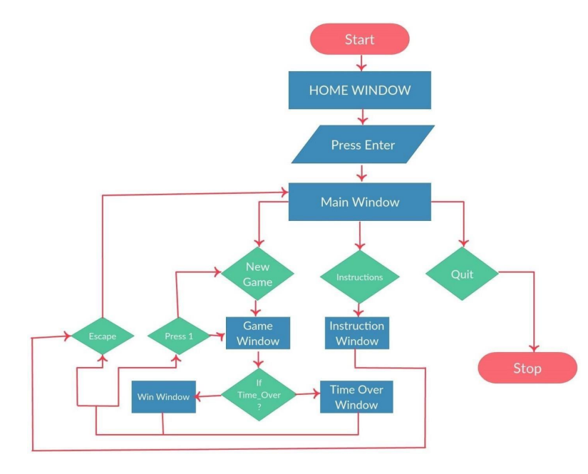
FLOW CHART

Slide 7
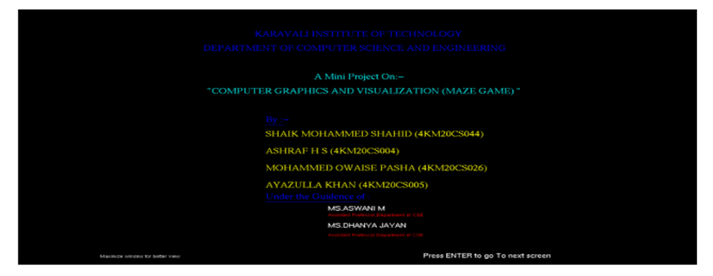
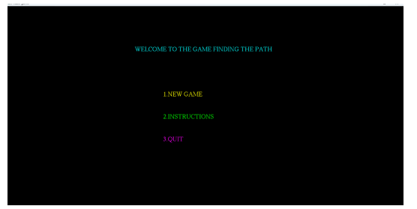
SNAPSHOTS
1.AFTER RUNNING THE PROGRAM
2.GAME MENU

Slide 8
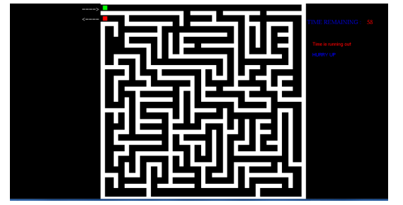
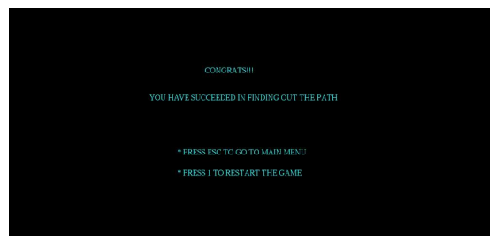
3.THE GAME
4.WIN SCREEN

Slide 9

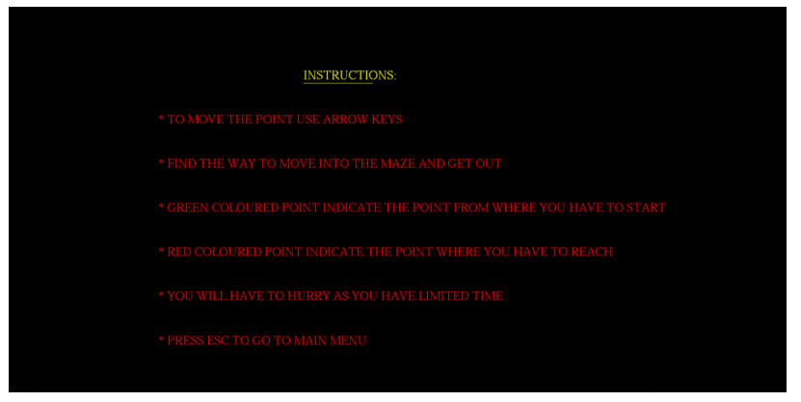
5.GAME OVER(LOST)
6.INSTRUCTIONS

Slide 10
IMPLEMENTATION
The Project which we have done uses OpenGL functions and is implemented using C. Our Project is to demonstrate MAZE GAME. User can perform operations using keyboard
Firstly, after compiling we get a Home Page.
➢ Then we click the Enter button to display the Main window here we get three options in which user has to specify his choices:
New Game: To start the new game.
Instructions: It Guides the user how to play the game.
Exit: Quits the Game.
➢ As the player clicks 1 i.e. To open the new game.
➢ Now in game the player uses the arrow key to complete the game.
➢ Regardless of a win or a lose the player is redirected to pop-up page, where again he has
to specify his choice.

Slide 11
THANK YOU

